Slide 1




Reproducing and Replicating Spatial Data Science
Joseph Holler, Peter Kedron, and Sarah Bardin
HEGSRR.github.io
Funding Support from NSF BCS-2049837, NSF OAC-1743184

Slide 2
Tell Us What You Think
Please take 2mins to complete a short survey about open science research practices
INSERT SURVEY LINK HERE BIG
GIVE ANY ADDITIONAL DETAILS FROM IRB HERE
Kedron et al.
Challenges and Breakthroughs in Replicable STDS
Symposium on STDS

Slide 3
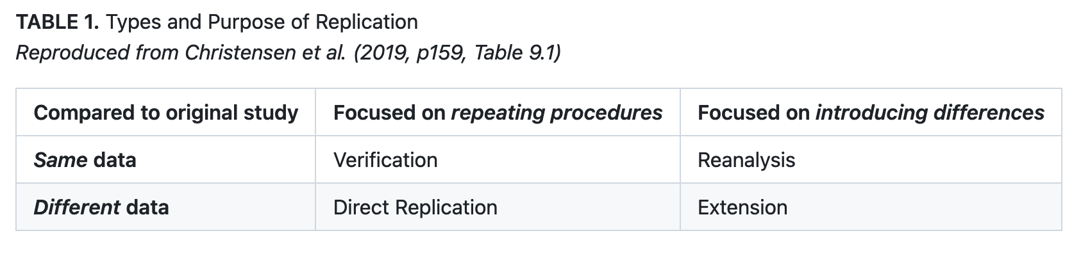
Reproduction and Replication
(Schmidt 2009, Gomez et al. 2010, Barba 2017, Christensen et al. 2019, NASEM 2019)
Kedron et al.
Challenges and Breakthroughs in Replicable STDS
Symposium on STDS

Slide 4
Reproduction and Replication
(Schmidt 2009, Gomez et al. 2010, Barba 2017, Christensen et al. 2019, NASEM 2019)
Reproduction
Same data, same procedure, same results, same context
Kedron et al.
Challenges and Breakthroughs in Replicable STDS
Symposium on STDS

Slide 5
Reproduction and Replication
(Schmidt 2009, Gomez et al. 2010, Barba 2017, Christensen et al. 2019, NASEM 2019)
Reproduction
Same data, same procedure, same results, same context
Replication
New data, similar procedure, similar results, same or new context
Kedron et al.
Challenges and Breakthroughs in Replicable STDS
Symposium on STDS

Slide 6
Format of this Virtual Workshop
Supporting R&R studies in spatial data science with an open access research/teaching template
INSERT SURVEY LINK HERE BIG
GIVE ANY ADDITIONAL DETAILS FROM IRB HERE
Kedron et al.
Challenges and Breakthroughs in Replicable STDS
Symposium on STDS

Slide 7
Open Science Practices
Selected open science and reproducibility supporting research practices
Share Data – Do you share data in a permanent location with a persistent identifier?
Share Methods and Code – Do you share a complete description of you methods?
Metadata – Do you provide information about the provenance of the components of your work?
Version control – Do you track and manage changes to your code?
Reproducible Computational Environment – Do you provide sufficient information about your work environment that others can recreate it?
Kedron et al.
Challenges and Breakthroughs in Replicable STDS
Symposium on STDS

Slide 8
Open Science Practices
Selected open science and reproducibility supporting research practices
Research Compendium – Do you collect all the digital components of your work together?
Digital Archive with DOI – Are all the components of your work stored and labelled with a permanent ID?
Pre-registration – Do you publicly register your hypotheses and research design before conducting your work?
Open Source Software – Do you use software that distributes its source code? Do you share yours?
Open Licensing – Do you openly license your work products to allow other to use/build on them?
Reproduction or Replication Studies – Do you attempt and share reproduction or replication studies?
Kedron et al.
Challenges and Breakthroughs in Replicable STDS
Symposium on STDS

Slide 9
Veridical Spatiotemproal Data Science
Munafo et al. (2016), Kedron et al. (2020), Yu & Kumbier (2020),
Principled inquiry to extract reliable and reproducible information from spatialtemporal data, with an enriched technical language to communicate and evaluate empirical evidence in the context of human decisions, domain knowledge, and geographic confounds; supported by a system of external validation and evidence accumulation based on the purposeful replication of findings across space and time.
(Adapted from Kedron and Bardin 2021, Yu and Kumbier 2020)
Kedron et al.
Challenges and Breakthroughs in Replicable STDS
Symposium on STDS

Slide 10
Spatiotemporal Data Science Lifecycle
Munafo et al. (2016), Kedron et al. (2020), Yu & Kumbier (2020),
Question
Communicate
Research Design
g
a
b
Data
Collection
Interpret
f
abcdefg = n
e
c
Data
Management
d
Modeling
& Analysis
Data
Exploration
Kedron et al.
Challenges and Breakthroughs in Replicable STDS
Symposium on STDS
Notes:
The practice of data science is commonly presented as a lifecycle. Researchers progress through a series of steps as they investigate a domain question and ultimately arrive at a conclusion. They then share that conclusion with others to inform decision making, add to our collective knowledge, and shape future work on similar questions.
As any researcher moves through this lifecycle, they make decisions with each step they take. Each of those decisions opens alternative research paths that could have been taken, and that might have led to different result and conclusions.
Unobserved Selection: The problem that many in the room are likely familiar with is that independent readers of the final published study often do not observe the decisions that the original researchers made, or the alternative results they may have discarded. Compounding this problem is the fact that it is still not common practice to share the research artifacts used to create the results, which would allow others to examine those alternatives themselves.
Explicit Selection: There is also the related problem of selecting and interpreting a subset of results from a much larger set of observable results without correcting for that large number of tests. For example, detecting a selecting spatialtemporal clusters using p-values without correcting for multiple testing.

